Slide 1
Just So you Know…
LEQ
Format
Turn In
SAQ
Never mind
Here you go
Chapter 21 Quiz
NEXT Monday (12/10)
Last chapter quiz of the semester!

Slide 2
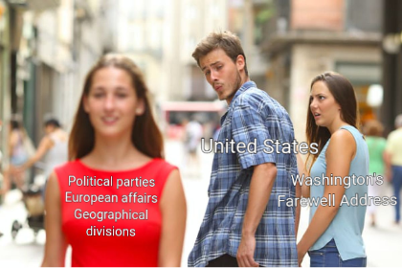
Drifting Toward Disunion
The American Pageant,
Chapter 19

Slide 3
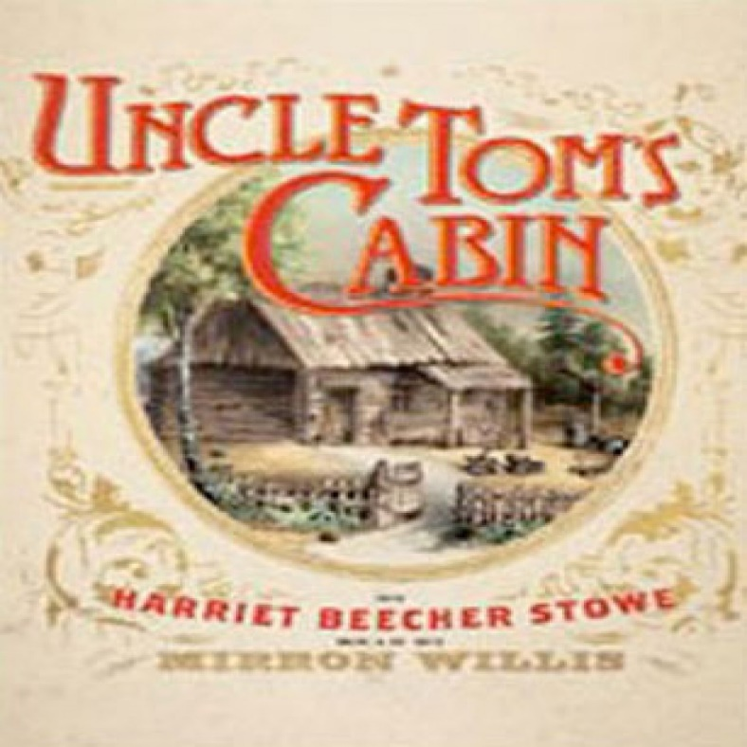
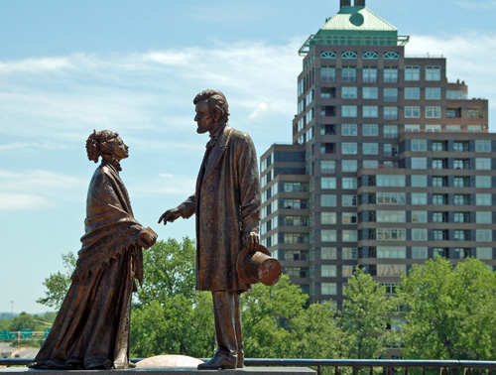
Northern Resistance
Uncle Tom’s Cabin, 1852
Resistance to slavery (Slave Act)
Morality issue
Lincoln’s response

Slide 4
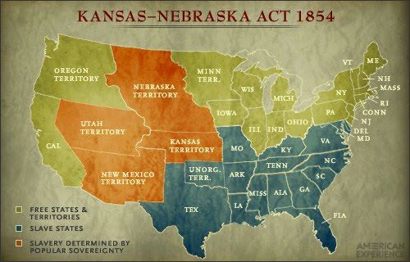
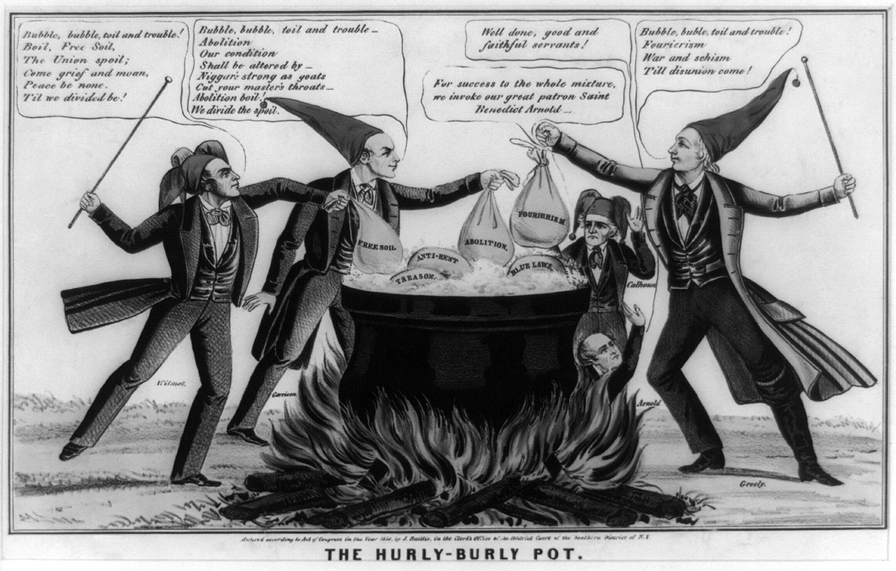
Kansas-Nebraska Act
“K, NA” or “K, Ne”
Popular Sovereignty
Assumptions
KA-slave, NE free
Pro- and anti-slavery forces move
Both sides flood to Kansas—rig elections
New England Emigrant Company
Free soil members
Border Ruffians
Pro-slavery

Slide 5
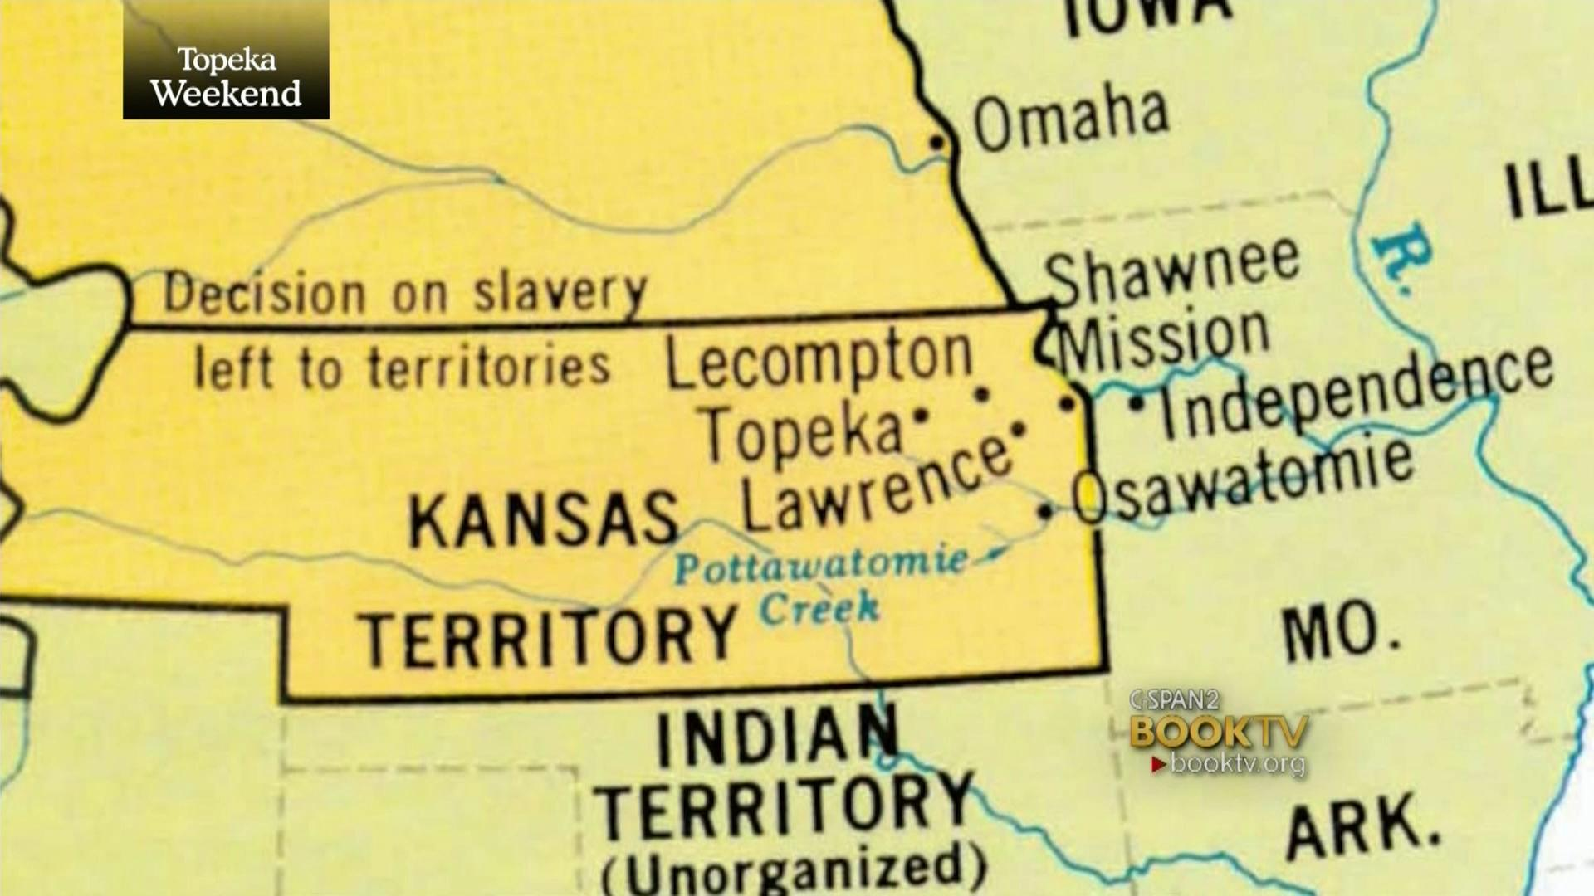
Results of “K, Na”
Intended to “democratize” the slavery issue
Makes things worse
Two rival governments established in Kansas
Topeka—free soil
Lecompton—slave
Leads to formation of Republican Party
Formed by anti-slavery groups

Slide 6
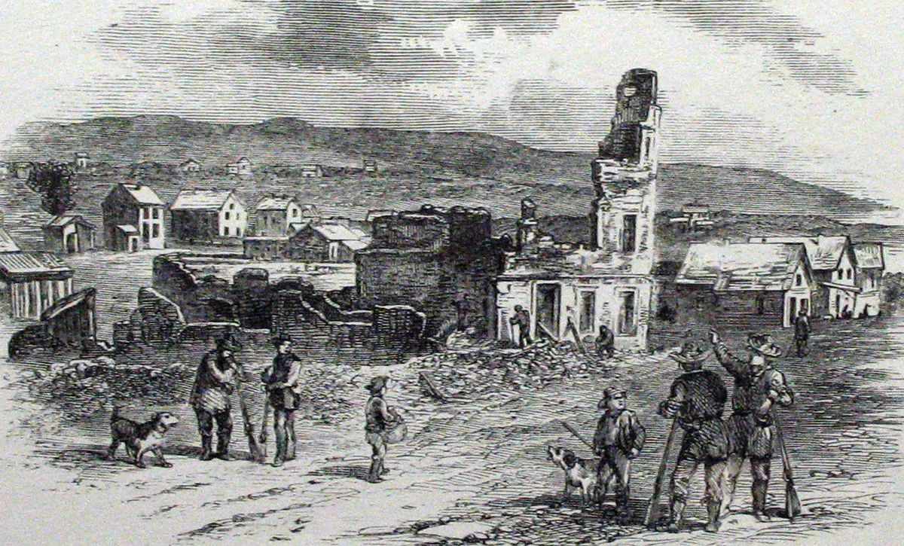
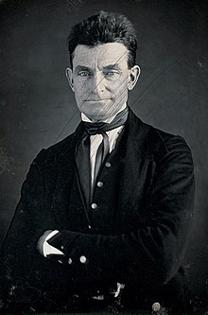
Bleeding Kansas
Sack of Lawrence, 1856
Free soilers attacked by pro-slavery forces
John Brown
Attack pro-slavery forces at Pottawatomie Creek
Hack to death pro-slavery people
Civil War already under way in Kansas

Slide 7
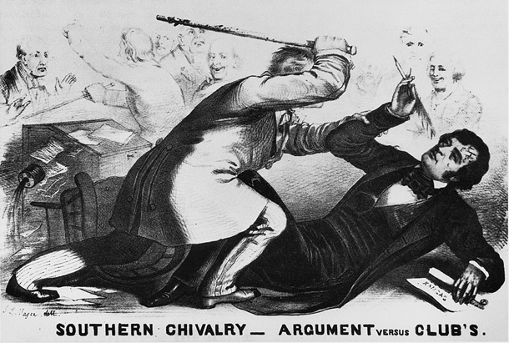
Fighting in Congress
Charles Sumner, (FS-MA)
Condemns events in Kansas
“Crimes Against Kansas”
Insults Andrew Butler
Southern senator
Preston Brook’s responds
The slavery issue is expanding and getting more tense
Sectionalism continues to grow between N and S

Slide 8
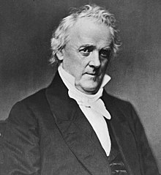
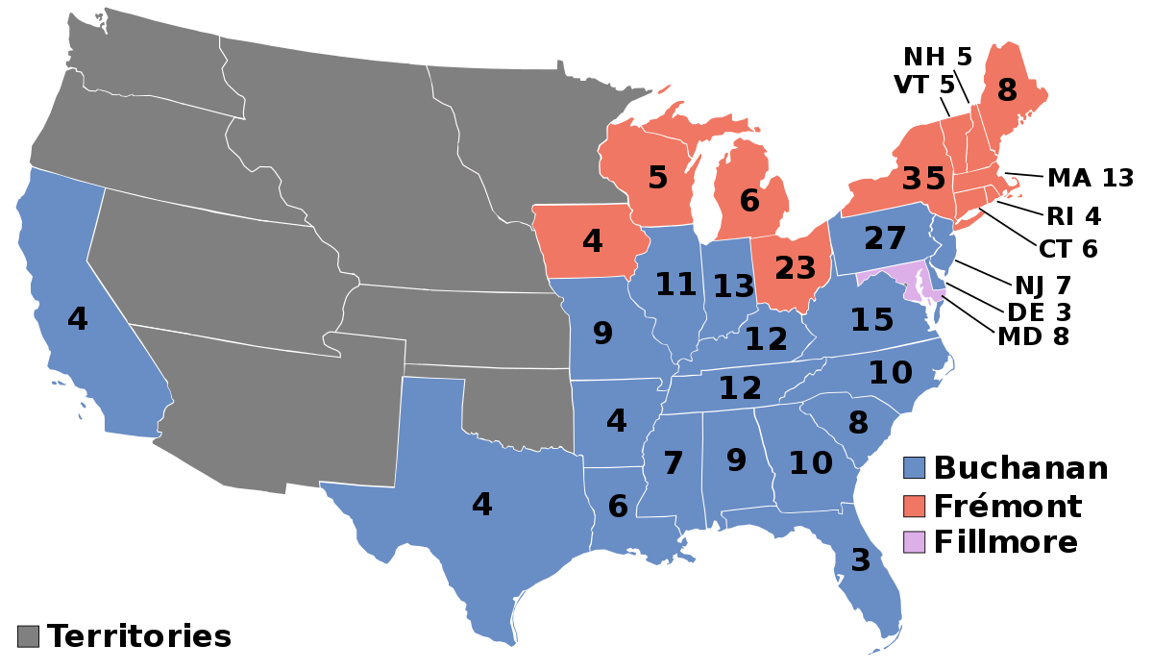
Election of 1856
Republicans—James C. Fremont
Democrats—James Buchanan
Not related to K-NE Act
Know-Nothings—Millard Fillmore
Republicans do well for first-time bid
Buchanan Wins

Slide 9
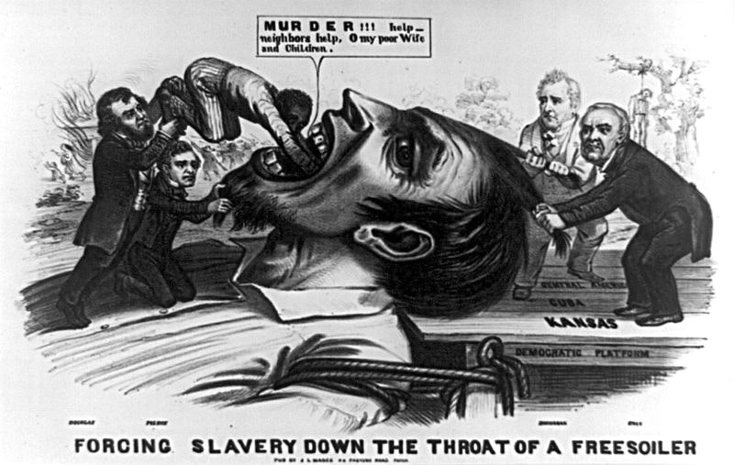
Buchanan's Dilemmas
Lecompton Constitution (Kansas)
Pro-Slavery
Passed
Free Soilers Boycott election of the constitution
Approved by Buchanan; Rejected by Congress
Is popular sovereignty working?
Let’s review

Slide 10
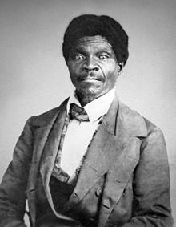
Scott v. Sanford
Dred Scott
Slave from south
Taken to free territory by owner
Sues for freedom

Slide 11
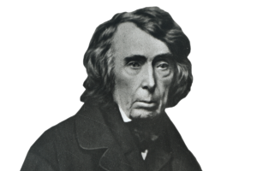
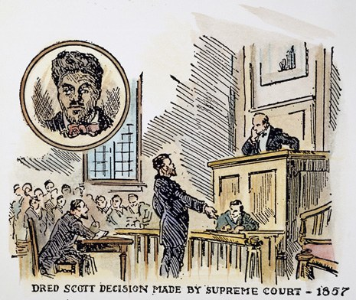
Scott v. Sanford
Case goes to SCOTUS in 1857
Chief Justice—Roger Taney
SCOTUS rules
African-Americans cannot sue
Slaves are property; 5th Amendment
Congress cannot make laws regarding slavery (property issue)
Missouri Compromise (already overturned) unconstitutional
This is an example of why judicial review matters!
Slavery opened to all territories—north is outraged!

Slide 12
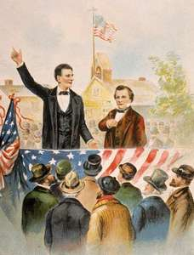
Lincoln-Douglas Debates
Lincoln (R) v. Douglas (D) for Senate
Series of seven debates in Illinois, 1858
Key Question: Can slavery be prevented?
Dred Scot case—No
Douglas—Freeport Doctrine
Territories can limit slavery
Upsets southerners
Douglas wins the senate seat, but Lincoln now recognized nationally
“House Divided” speech

Slide 13
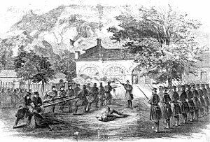
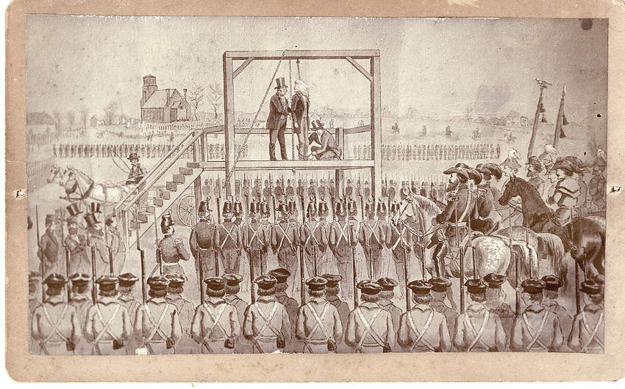
John Brown; Harper’s Ferry (1859)
John Brown—wants to spark a slave revolt
Wants to seize the federal arsenal at harper’s Ferry
To no avail
John Brown—treason (death by hanging)
Impact—
South is outraged
Brown is martyred
Moves towards secession
South under attack
Politically, socially, economically, physically

Slide 14
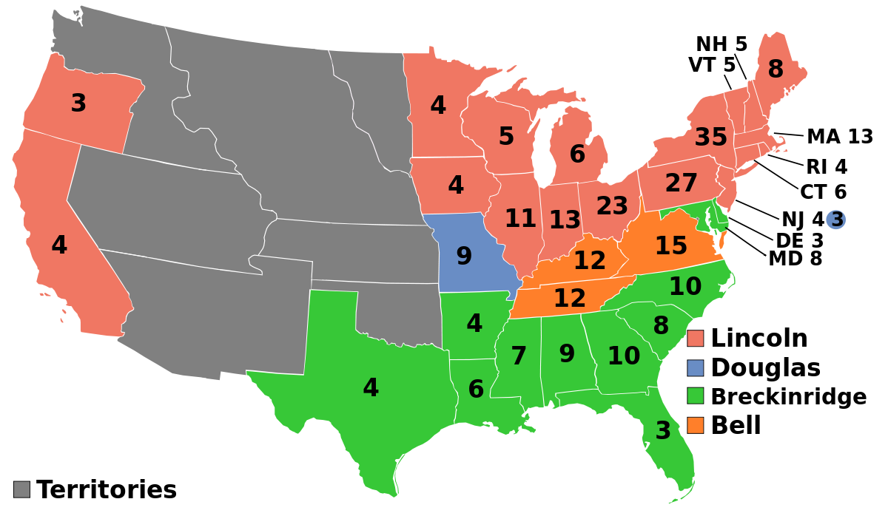
Election of 1860
Democrats Split
Slavery; Popular Sovereignty
Northern Democrats—Stephen Douglas
Popular Sovereignty
Southern Democrats—John Breckenridge
Allow slavery; annex Cuba
Republicans—Lincoln
Constitutional Union Party—John Bell
Avoid the slavery issue; just enforce the Constitution
Importance of the third party
What’s the Problem?

Slide 15
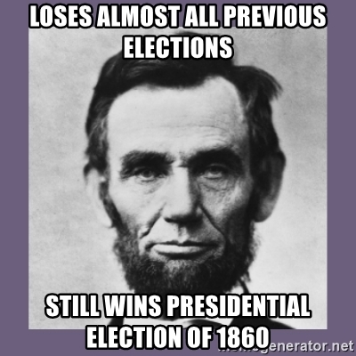
Republican Platform
Lincoln’s Agenda appeals to Free Soilers
No extension of slavery
Protective tariffs for manufacturing (hurts south)
Pacific Railroad for the Northwest
Homesteads (MUST KNOW FOR STAAR)

Slide 16
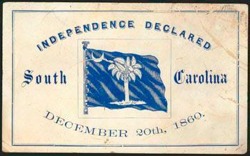
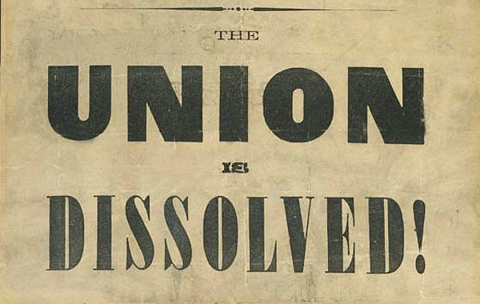
Election of 1860
Lincoln wins!
Minority President
Sectional President
Not on ballot in 10 states
South Carolina secedes first
Six others follow suit
Jefferson Davis chosen as the Confederacy’s first (and only) president
Buchanan is a lame duck—does nothing!

Slide 17
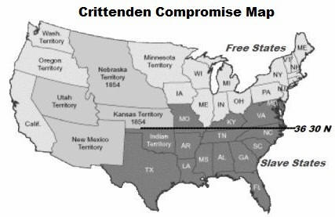
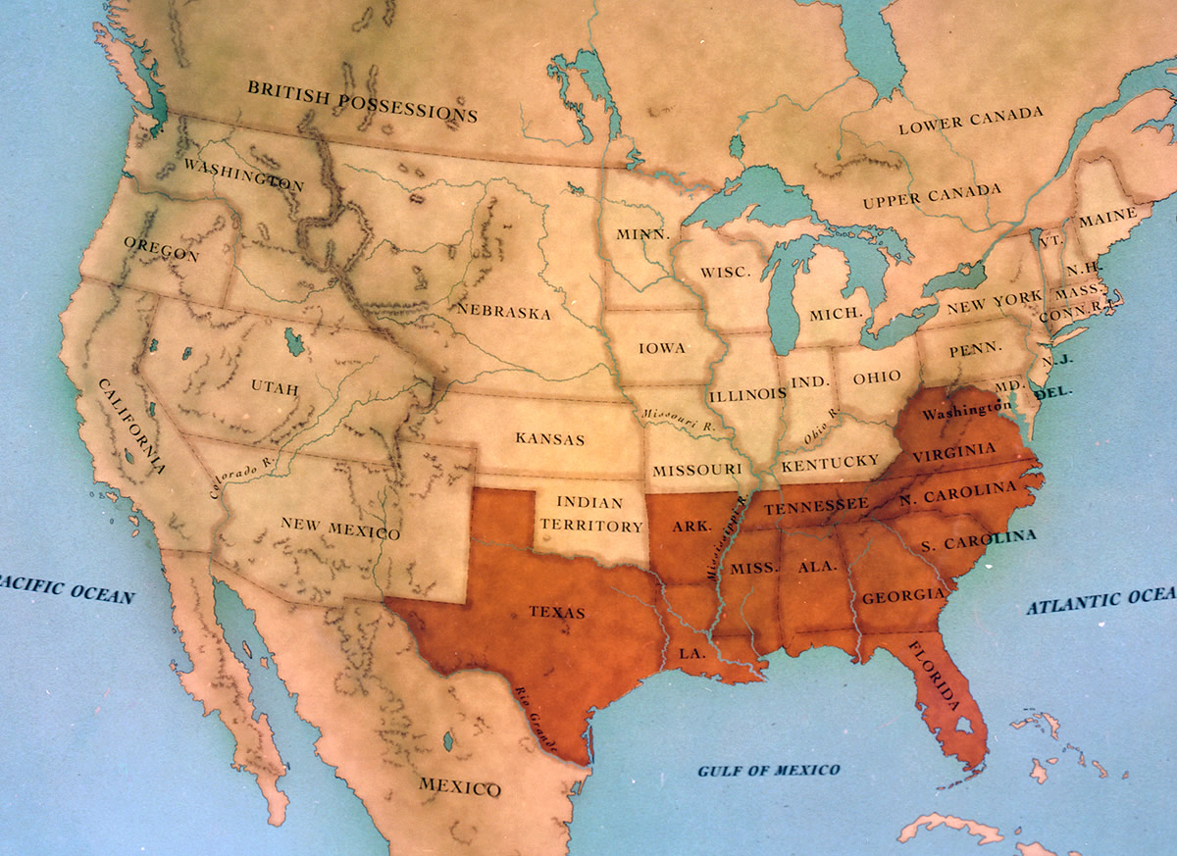
One Last Chance to Compromise
Crittenden Compromise
Attempt to avoid crisis
Calm Southern fears
Return to Missouri Compromise
Slavery prohibited north of 36, 30
Slavery allowed south of 36, 30
Lincoln rejects it
Violates his platform of slavery not extending
More states leave the Union
Before Lincoln takes office—
South Carolina, Mississippi, Florida, Alabama, Georgia, Louisiana and Texas secede

